Slide 1
Assembly Language Lab (7)

Slide 2
CH4: Data Transfers, Addressing, and Arithmetic

Slide 3
Addressing Modes
Immediate
Register
Direct Memory
Direct Offset
Indirect Memory
Base
Base-Index
Base-Index with displacement

Slide 4
Immediate Addressing
MOV EAX, 1

Slide 5
Register Addressing
MOV EAX, EBX

Slide 6
Direct Memory Operands
Using variable name (X)
MOV EAX, X
MOV EAX, [X]

Slide 7
Direct-Offset Operands
Constant offset is added to a named memory location to produce an effective address
.data
arrayB BYTE 10h, 20h , 30h, 40h, 50h
.code
mov al, arrayB ;AL = 10h
Mov al, arrayB[0]
mov al, [arrayB + 1] ;AL = 20h
mov al, [arrayB + 2] ;AL = 30h

Slide 8
Indirect Addressing
Base
MOV ESI, OFFSET arr
MOV EAX, [ESI]

Slide 9
Indirect Addressing
Base-Index
MOV ESI, OFFSET arr
MOV EDI, 1
MOV EAX, [ESI + EDI]

Slide 10
Indirect Addressing
Base-Index With displacement
MOV ESI, OFFSET arr
MOV EDI, 1
MOV EAX, [ESI + EDI + 3]

Slide 11
Data-Related Operators
OFFSET Operator
PTR Operator
TYPE Operator
LENGTHOF Operator
SIZEOF Operator

Slide 12
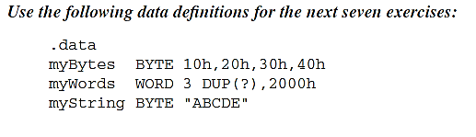
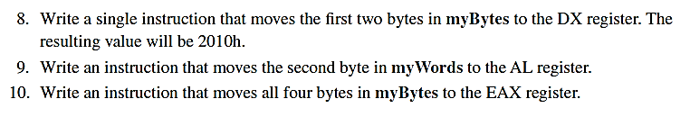
Review
Notes:
8. mov dx, WORD PTR myBytes
9. mov al, BYTE PTR myWords + 1
10. mov eax, DWORD PTR myBytes

Slide 13
Review
Consider the following declarations
.data
list1 DWORD 1020h, 3040h
list2 WORD 50h, 6070h, 80h
The number of bytes of list1 can be calculated as
c. list1Bytes = ($ - list1)
list1Bytes BYTE ($ - list1) d. None of the above
list1Bytes = ($ - list1) – ($-list2)
Notes:
a)

Slide 14
Review
.data list DWORD 10, 2 DUP(2 DUP(20)) .code mov edx, SIZEOF list
What is the value of EDX after executing that code?
a. c. 4
b. 5 d. 2
20
Notes:
a)

Slide 15
Review
What is the value of eax after executing the following code?
.Data arr WORD 30h, 40h, 50h, 60h
.Code
Mov esi,offset arr
Mov eax , [esi]
Add eax , [esi+2]
Add eax , [esi+4]
a) 00F000C0h
c) 12h
b) 00C000F0h d) D0h
Notes:
a)

Slide 16
Status Flags
Zero
Sign
Carry
Auxiliary Carry
Overflow
Parity

Slide 17
Flags
CF = Carry out of MSB
OF = (carry out of the MSB) XOR (carry into the MSB)
SF = Copy of MSB
AC = Carry out from bit 3 to bit 4, LSByte
PF = Even number of ones in LSByte
ZF = result == 0 ?

Slide 18
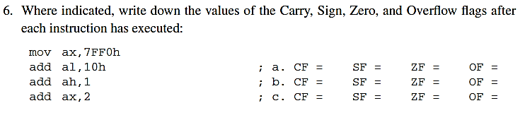
Review
Notes:
6. Write down the following flag values:
(a) CF1, SF 0, ZF 1, OF 0
(b) CF 0, SF 1, ZF 0, OF 1
(c) CF 0, SF 1, ZF 0, OF 0

Slide 19
1. MOV AX, 4321h
2. ADD AX, 1234h
3. NEG AX
4. DEC AX
What are the values of the flags after executing line 3?
a) CF = 1, SF = 1, ZF = 0, OF = 0, AF = 1, PF = 1
b) CF = 0, SF = 1, ZF = 0, OF = 0, AF = 0, PF = 0
c) CF = 0, SF = 1, ZF = 0, OF = 0, AF = 1, PF = 0
What are the values of the flags after executing line 4?
a) SF = 0, ZF = 0, OF = 0, AF = 0, PF = 1
b) CF = 0, SF = 0, ZF = 0, OF = 0, AF = 0, PF = 1
d) CF = 1, SF = 0, ZF = 0, OF = 0, AF = 1, PF = 0
d) CF = 1, SF = 1, ZF = 0, OF = 0, AF = 1, PF = 0
c) SF = 1, ZF = 0, OF = 0, AF = 0, PF = 1
Notes:
D
C

Slide 20
Review
Which code will set the AF?
a) c. mov EBX, 0
add EBX, 3
b) mov EBX, 10 d. mov EBX, 15
sub EBX, 4 sub EBX, 5
mov EBX, 10
add EBX, 9
Notes:
a

Slide 21
CH5: Procedures

Slide 22
You have to know …
How to declare PROC and CALL it
Why do we use stack (USES) && How?
Ret Vs. Exit What happen if we forget it?
On CALL the value of EIP is pushed automatically
On ret the top of the stack is popped into EIP automatically
Notes:
*We can review the idea behind the top-down design quickly
*Stack operations (PUSH/PUSHFD/PUSHAD) and their pop version

Slide 23
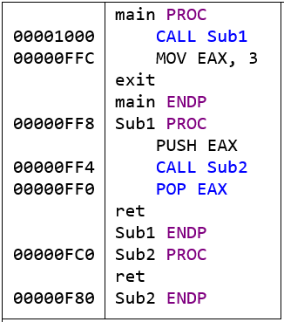
Runtime stack
What are the stack values after each stack statement?
1
2
3
6
5
4
Notes:
On board, take care of push direction
After statement “1”:
0000FFC ← Top of the stack
2. After statement “2”:
3 ← Top of the stack
0000FFC
3. After statement “3”:
0000FF0 ← Top of the stack
3
0000FFC
4. After statement “4”:
3 ← Top of the stack
0000FFC
5. After statement “5”:
0000FFC ← Top of the stack
6. After statement “6”:
← Top of the stack

Slide 24
Runtime Stack
Notes:
SUB ESP, 4
MOV [ESP], EAX

Slide 25
Review
What will be the value in the EDI register after executing line 4?
1 | pushAD
2 | push EDI
3 | popAD
4 | pop EDI
a) Value of EDI
c) Value of EAX before line 1
b) Value of Eflags before line 1 d) Value of ESI before line 1
Notes:
c)

Slide 26
CH6: Conditional Processing

Slide 27
Content
Bitwise Operations
Conditional Jumps
Unsigned
Signed
Conditional Structures
(Translate any C++ expressions grouped by OR/AND into assembly instructions)

Slide 28
Review
Which flags does the CMP instruction change?
CF, ZF
SF, OF d. CF, AF, SF, OF
Which instruction will set the sign flag?
a. and dl, 80h c. xor dl, 80h
b. test dl, 80h
c. CF, ZF, SF, OF
d. or dl, 80h
Notes:
C
D

Slide 29
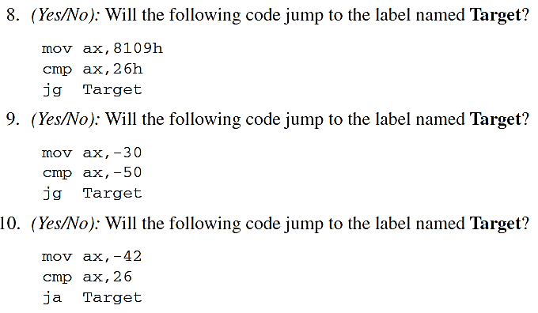
Review
Notes:
8. No (8109h is negative and 26h is positive).
9. Yes
10. Yes (the unsigned representation of 42 is compared to 26)\

Slide 30
Review
Notes:
13. Code:
and al,11111100b
jz L3
jmp L4

Slide 31
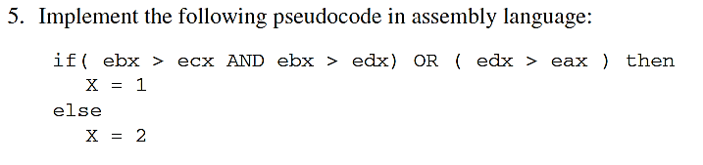
Review
Notes:
5. Code example:
cmp ebx,ecx ; ebx > ecx?
jna L1 ; no: try condition after OR
cmp ebx,edx ; yes: is ebx > edx?
jna L1 ; no: try condition after OR
jmp L2 ; yes: set X to 1
;-----------------OR(edx > eax) ------------------------
L1:
cmp edx,eax ; edx > eax?
jna L3 ; no: set X to 2
L2: mov X,1 ; yes:set X to 1
jmp next ; and quit
L3: mov X,2 ; set X to 2
next:

Slide 32
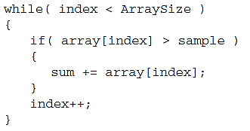
Solved Example, All unsigned DWORD
Notes:
MOV ESI, Index
MOV EAX, 0 ;rest Accumulator
MOV EBX, sample
beginWhile:
CMP ESI, ArraySize ; while condition
JNB endWhile
CMP array[ESI], EBX ;If condition
JNA continueLoop
ADD EAX, array[ESI] ;if body
continueLoop:
ADD ESI, 4
JMP beginWhile
endWhile:
MOV sum, EAX

Slide 33
Hands-on
Let’s get started!

Slide 34
IS A STRING PROC Style
Given a string, write a procedure the check whether it is string or number. The input string is not a number if there is at least 1 character in it.
Sample Run
Enter input: S11111
String
Enter input: 12312535
Number
Enter input: SDSSWW
String
Enter input: 12341W22
String

Slide 35
Trim Vowels PROC Style
Write a PROCEDURE that removes vowel characters from a string. Sample Run: Please, Enter your String: Hello World ! Output: Hll Wrld !
Please Enter your String: Assembly 2017 Output: ssmbly 2017

Slide 36
Thanks!

